Slide 1
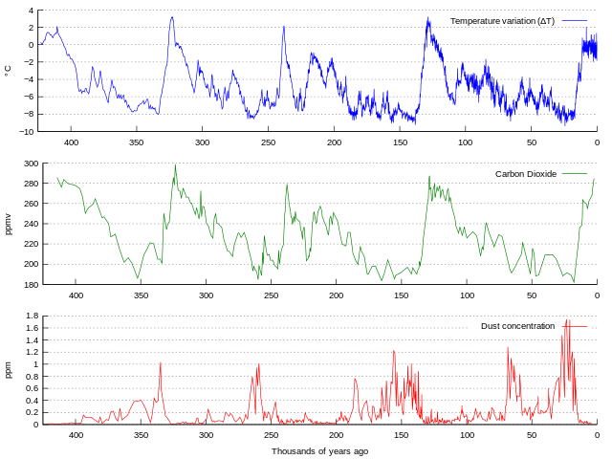
Reconstructed Temperature data
from the Vostok Ice Core in Antarctica
-53
Temperature
-55
-57
-59
-61
-63
-65
Thousands of Years before present (0=1948)
J. R. Petit et. al. “Climate and atmospheric history of the past 420,000 years from the Vostok ice core, Antarctica.” Nature 399, 429-436 (3 June 1999)

Slide 2
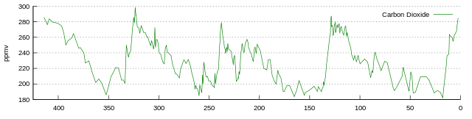
Reconstructed Temperature and Carbon Dioxide data
from the Vostok Ice Core in Antarctica
2013 Mean CO₂= 396.5 ppm
Carbon Dioxide
-53
Temperature
-55
-57
-59
-61
-63
-65
Thousands of Years before present (0=1948)

